Slide 1
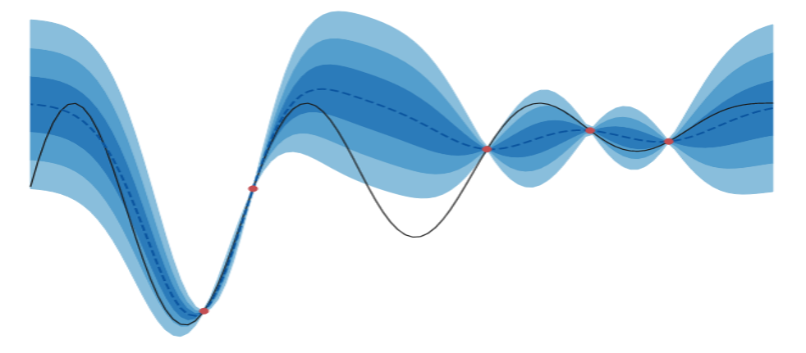
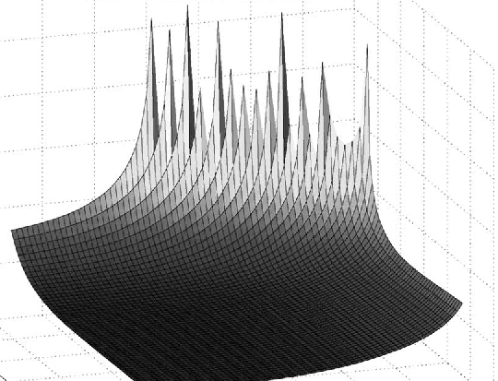
Bayesian Optimization to find optimal Setup and Hold timing for a D Flip-Flop in CharLib
Images from:
https://blog.quipu-strands.com/bayesopt_2_acq_fns
https://www.semanticscholar.org/paper/Exploiting-Setup%E2%80%93Hold-Time-Interdependence-in-Salman-Dasdan/c3c5eef8a5b41fe6d787b32d99eef9df0106cc7f
Ricardo Landeros Aranda

Slide 2
What is CharLib?
Charlib is an open-source standard cell library characterizer.
It allows the users to:
Support characterization of combinational and sequential cells.
Plots timing and I/O voltages.
Supports non-linear delay models in the liberty file format (.lib).
Runs characterization in parallel on multiple cores.
Created by Marcus Mellor and Dr. James E. Stine
Source: https://stineje.github.io/CharLib/chapters/01_introduction.html

Slide 3
What is Bayesian Optimization?
Bayesian Optimization (BO) is a sequential model-based strategy for global optimization of black-box objective functions whose evaluations are costly. It is often used when a single observation requires an experiment, engineering computation, numerical simulation, or when derivatives are unavailable or unreliable. In simpler forms the objective does not require to have a closed-form expression.
This method builds a probabilistic model of the unknown function, often a Gaussian process (GP), and uses the predictive distribution to choose the next evaluation point. The next point is chosen by optimizing the criteria, done by an acquisition function.
Sources: https://en.wikipedia.org/wiki/Bayesian_optimization
https://www.geeksforgeeks.org/artificial-intelligence/bayesian-optimization-in-machine-learning/#what-is-bayesian-optimization

Slide 4
The problem
When we study the behavior of a D Flip-Flop Charlib runs SPICE simulations along a set of points for setup and hold times to test the cell (D Flip-Flop). These two aspects of the D Flip-Flop are evaluated to determine if the chosen points will cause the cell to become metastable, which is the main concern for this research.
Ideally we want the minimum setup and hold times that we can use to clock and deliver Q without reaching into a metastable state.
Currently, searching for those values while satisfying the constrains is a slow costly process, the goal is to: still reduce this metastability risk while improving simulation runtime and having a faster overall characterization.

Slide 5
Why do we care?
Once a well defined set of values for of setup and hold times is defined we have to run a simulation to examine how the flip-flop will behave under certain given conditions.
This would be no issue if the simulations were low cost and easy to evaluate, but each of these grid points has to be evaluated in a SPICE simulation in order to determine the behavior. This results in a very computationally expensive process if we do it repeatedly, which is the case with the flip-flop making a 40x40 grid evaluation a very heavy process for the simulation.

Slide 6
Current approach and limitations
The current process to find the optimal latching point uses a robust sweeping evaluation over the hold and setup values.
This approach is very robust and with enough time and resources it finds and optimal latching point.
However this process is not optimal since every point evaluation is expensive to simulate.
One good thing to mention about this approach is that it exploits the monotonicity nature of the shape that we are dealing with.
Once a value latches other time instances bigger than that value are guaranteed to latch.

Slide 7
Charlib and BO
Using linear sweep is a good approach if the amount of points to evaluate is small. However, as the amount of points given in the setup and hold time grid increases, the linear sweep approach results in a very costly and slow tool to determine the most optimal point.
In exchange, BO is a promising alternative because it does not evaluate every single point. Instead, it takes a few initial guesses to determine the relationship between points and then choose where to sample next. This reduces the number of calls for simulations (less than 1600) in a great measure since at each iteration for the next point the BO process improves its guesses since it knows more about the shape, thus reducing the number of calls.
It also allows the user to manually tune its parameters to aim for a specific pace, add kernels or combine them, as well as using different acquisition functions that aim for different searching criteria.

Slide 8
Important aspects of BO and its application to Charlib
BO is a series of processes, for which the main ones are: a kernel that samples the covariance of the function, a covariance matrix that tells us how different points relate to each other, a gaussian process which is a statistical tool that provides a probability distribution over different functions, and an acquisition function that chooses the next best point to sample.
Being the kernel, and acquisition function the main parameters to modify when trying to optimize or aim for certain points of a given function or shape.

Slide 9
Acquisition function and LSE
At first hand BO is a global optimization tool, only chasing for maximum or minima values, not middle points. This is a problem at first hand since the goal in this CharLib case is not a global optimization problem but an optimized search process.
Luckily we are able to shift the goal of BO from chasing global values to find a set threshold, this is part of a branch of statistics called Level Set Estimations (LSE). We are able to do such thing by changing our acquisition function from a mere Upper Bound Confidence (UBC) for a straddle acquisition function to search for a determined threshold, allowing us to search for a pass/fail threshold inside a black box function, which is a great tool to approach the values grid for the flip-flop reducing the number of calls and thus, the number of simulations.

Slide 10
Current state and future work
Currently, we have build a BO process using only NumPy and SciPy since those are the base libraries that CharLib uses for its processes.
So far the BO process has only been tested with toy functions and with a global maxima-chasing acquisition function.
The next step is to change the acquisition function for a LSE one, that will allow us to change the search process and try the new modified BO in a real set of values produced by a CharLib simulation result, giving a broader look to how this process works and if there are promising results if we proceed with this apporach.
If this works, the step after will be to integrate the BO process in CharLib replacing the old sweep across setup and hold grid.

